Slide 1
Core Telecom Customer Complaints ELT Platform
By Ugwuede Chidiogo Choice

Slide 2
Problem Statement
Complaints come from many channels (Website, Social Media, Call Center).
No unified reporting system.
Needed an automated pipeline for:
Ingestion
Transformation
Modeling
Analytics

Slide 3
Solution Overview
The solution includes:
Automated data extraction
Central storage
Airbyte
in S3
for ingesting raw data into Snowflake
from all sources
dbt
Airflow
Docker
for modeling, cleaning and enrichment
for orchestration
for consistent environment
Power BI dashboard
for analytics

Slide 4
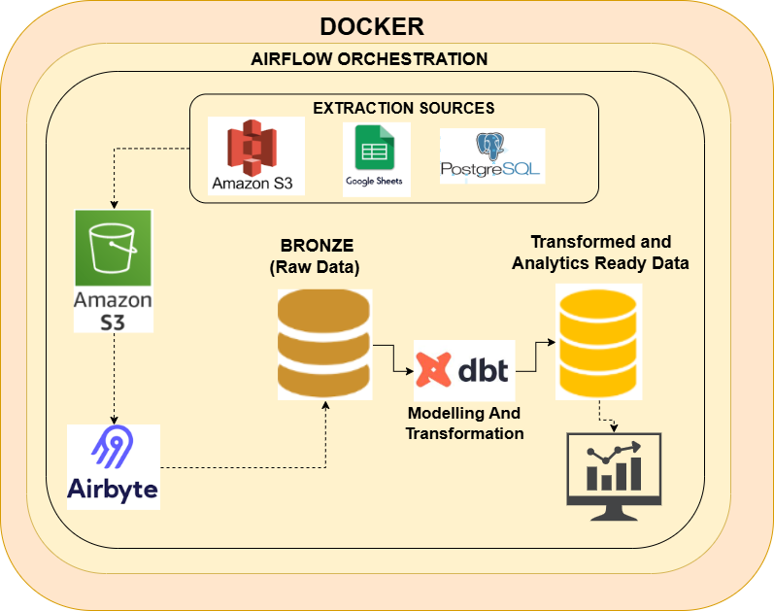
Architecture

Slide 5
Architecture Flow
Triggered by Airflow
01
02
03
Data Sources
Extraction
Airbyte pulls
S3, Google Sheets, Postgres
stores raw parquet in S3
from S3 → loads into Snowflake Bronze
04
05
dbt transforms
Power BI connects
Bronze → Staging → DataOps (Gold)
to Gold table for reporting

Slide 6
Data Ingestion
Python extraction scripts (CSV, JSON, Spreadsheet, Postgres)
Logging + error handling
Loaded to S3 in parquet format
Metadata fields for load time

Slide 7
Storage & Modeling
In Snowflake:
Modeling with dbt:
Bronze = Raw Airbyte loads
Surrogate keys
Silver = Cleaned + validated
Incremental models
DataOps (Gold) = Final complaint master table
Merge for dimensions
Append for fact tables
SCD1 logic (dimension tables don’t need history)

Slide 8
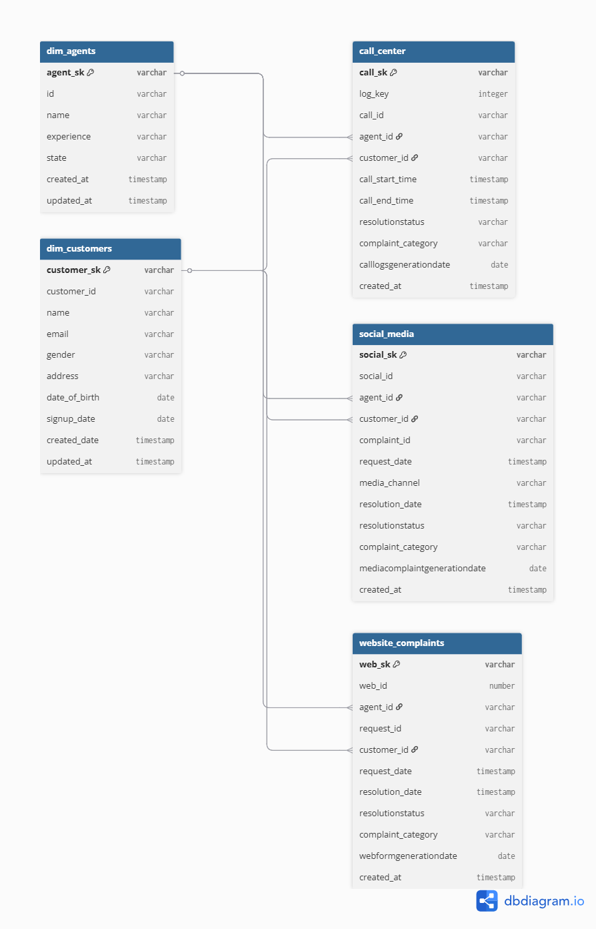
Entity
Relationship
Diagram

Slide 9
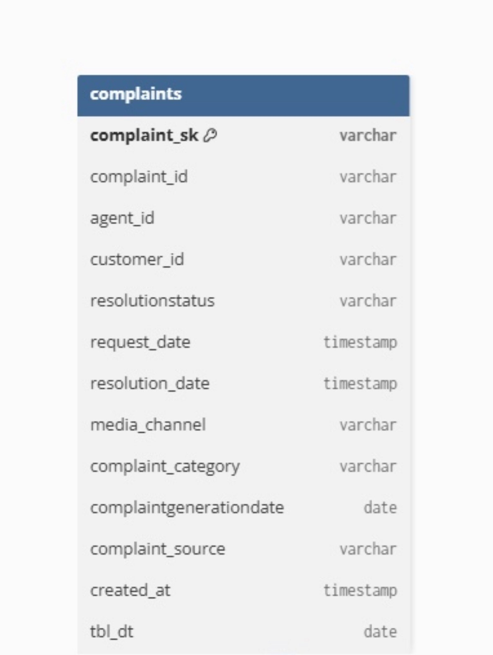
Final Gold Table

Slide 10
Dashboard
Focus areas on daily basis:
Active Customers
Active Agents
Total Complaints
Complaint Source
Channel distribution
SLA monitoring

Slide 11
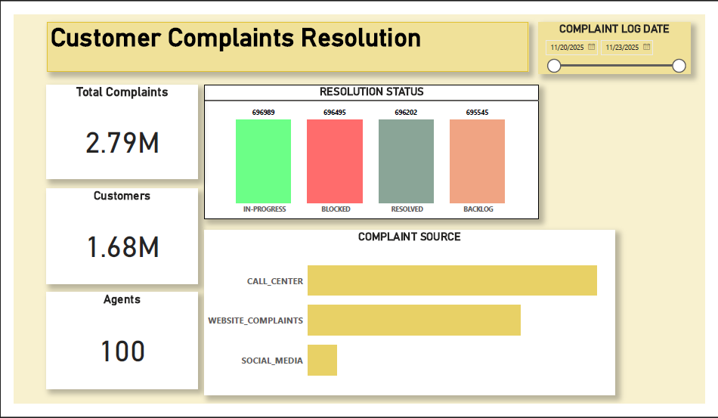

Slide 12

What This Enables
Faster decision-making
Clean single source of truth
Automated, repeatable workflows
Accurate cross-channel analytics

Slide 13
Thank you

